Slide 1


CMR TECHNICAL CAMPUS UGC(Autonomous) Kandlakoya, Medchal Road, Hyd-501401 Department of Computer Science and Engineering A Mini Project Review:03 STUDENTS PERFORMANCE PREDICTION IN ONLINE COURSES USING MACHINE LEARNING ALGORITHMS Batch No : 05
Group Members: Under the Guidance of :
Alampally Santhosha-207R1A05J1 Najeema Afrin
Yapakayala Rajendar- 207R1A05P8 Assistant Professor
Bannuru Sahithi -207R1A05J9

Slide 2
Contents:
Abstract
Existing System
Disadvantages of Existing System
Proposed System
Advantages of Proposed System
Hardware and Software Requirements
Novelty of the Project
Architecture
Modules

Slide 3
UML Diagrams
Sample Code
Result
Conclusion
Future Scope
References
Github Link

Slide 4
Abstract:
Advances in Information and Communications Technology (ICT) have increased the growth of Massive open online courses (MOOCs) applied in distance learning environments.
Various tools have been utilized to deliver interactive content including pictures, figures, and videos that can motivate the learners to build new cognitive skills.
High ranking universities have adopted MOOCs as an efficient dashboard platform where learners from around the world can participate in such courses.
The students learning progress is evaluated by using set computer marked assessments and computer gives immediate feedback to the student once they completes the online assessments.
In this project,Two predictive models have been designed namely student assessments grades and final student performance.

Slide 5
Existing System:
Educators often rely on traditional methods to assess student performance. These methods may include periodic exams, quizzes, and assignments. However, these assessments might not provide a comprehensive understanding of each students progress .
Educators may also use qualitative observations or feedback from students to guide their performance. While these approaches can be insightful, they are subjective and may not capture all relevant factors influencing student success in online courses.
Overall, the existing system lacks a systematic approach to predict student performance accurately. It relies heavily on manual assessment and may overlook early warning signs of struggling students. This can result in delayed interventions and decreased overall student engagement and success in online courses.

Slide 6
Disadvantages of Existing System:
Lack of Personalization
Limited Predictive Power
Inefficient Resource Allocation
Limited Scalability

Slide 7
Proposed System:
In our proposed system, we aim to create a user-friendly and effective tool to support educators in understanding and assisting their students better.
Firstly, we will gather various types of data from online learning platforms, such as student demographics, academic history, and their interactions within the course. This data will provide valuable insights into students behaviors and patterns.
Next, we will process this data, We look for important patterns and trends in the data that could indicate how well a student is likely to do in the course.
Then , select machine learning algorithms to build our predictive models. These algorithms will learn from the patterns in the data to make predictions about how likely a student is to succeed
Finally, we will deploy our models into the online learning platform or a separate application where educators can easily access and use them.

Slide 8
Advantages of Proposed System:
Personalized Support
Efficient Resource Allocation
Continuous Improvement
Enhanced Student Engagement
Scalability

Slide 9
SYSTEM REQUIREMENTS
HARDWARE REQUIREMENTS:
PROCESSOR : I3.
Hard Disk : 40 GB.
Ram : 4 GB.
SOFTWARE REQUIREMENTS:
Operating system : Windows10
Frontend :Html ,CSS , Javascript
Coding Language : Python
Data Base : MYSQL

Slide 10
Novelty of the Project:
The novelty of our project lies in its innovative approach to predicting students performance in online courses using machine learning algorithms. Unlike traditional methods that basic statistical analyses, our system advanced machine learning techniques to generate accurate predictions.
By integrating data from online learning platforms, including student Attendance, academic history, and course interactions, we can gain deeper insights into students behaviors and learning patterns.
Ultimately improving student outcomes and fostering a more engaging and personalized learning experience.

Slide 11
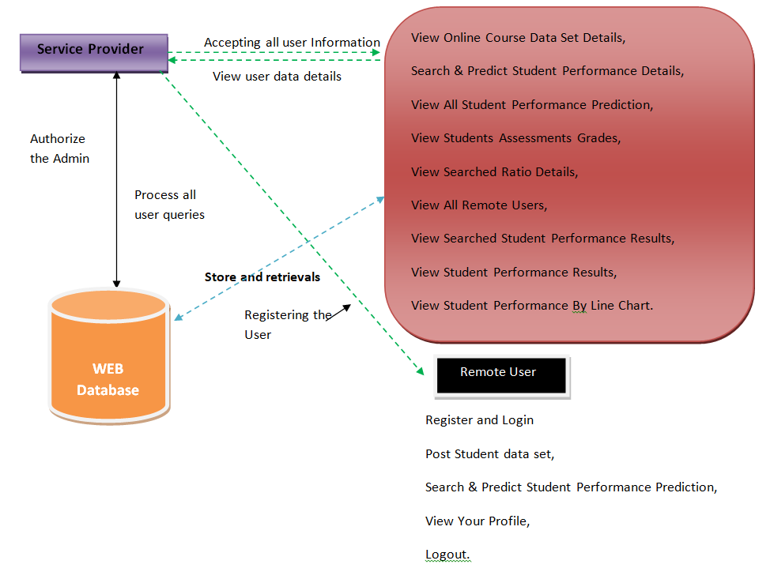
Architecture:

Slide 12
Modules:
Service Provider
In this module, the Service Provider has to login by using valid user name and password. After login successful they can do operations such as View Online Course Data Set Details ,Search & Predict Student Performance Details ,View All Student Performance Prediction, View Students Assessments Grades ,View Searched Ratio Details ,View All Remote Users ,View Searched Student Performance Results , View Student Performance Results ,View Student Performance By Line Chart.
View and Authorize Users
In this module, the admin can view the list of users who all registered. In this, the admin can view the user’s details such as, user name, email, address and admin authorizes the users.
Remote User
In this module, there are n numbers of users are present. User should register before doing any operations. Once user registers, their details will be stored to the database. After registration successful, he has to login by using authorized user name and password. Once Login is successful user will do some operations like Post Student data set, Search & Predict Student Performance Details , View Your Profile.

Slide 13
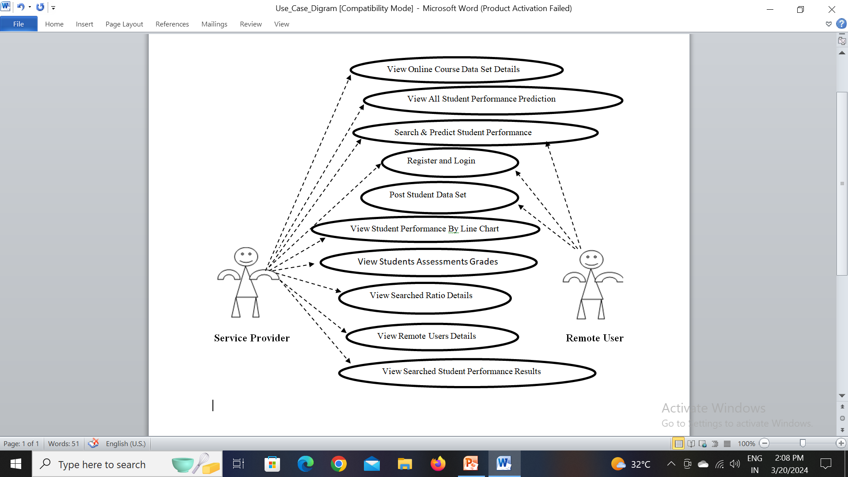
UML Diagrams: Use case Diagram:

Slide 14
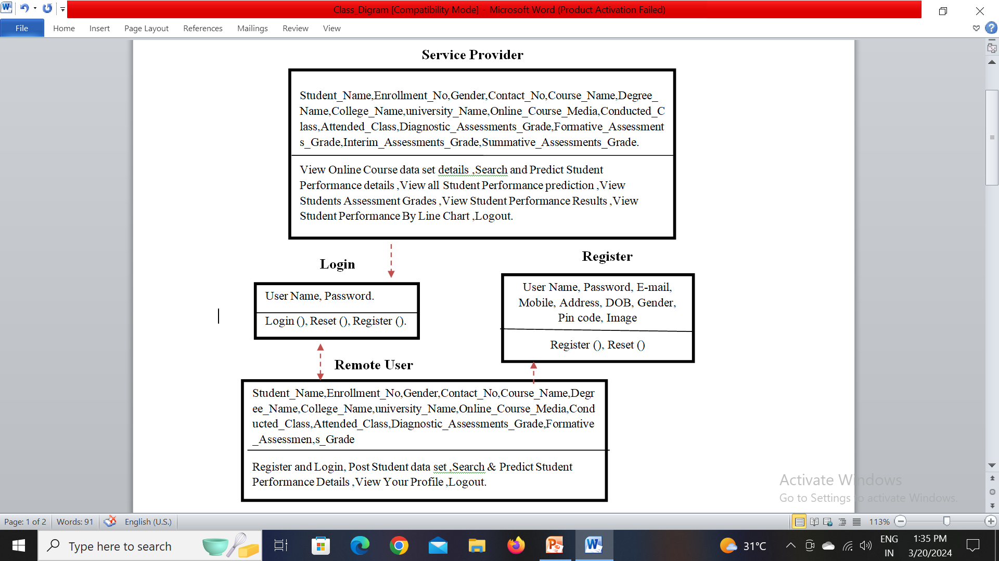
Class Diagram:

Slide 15
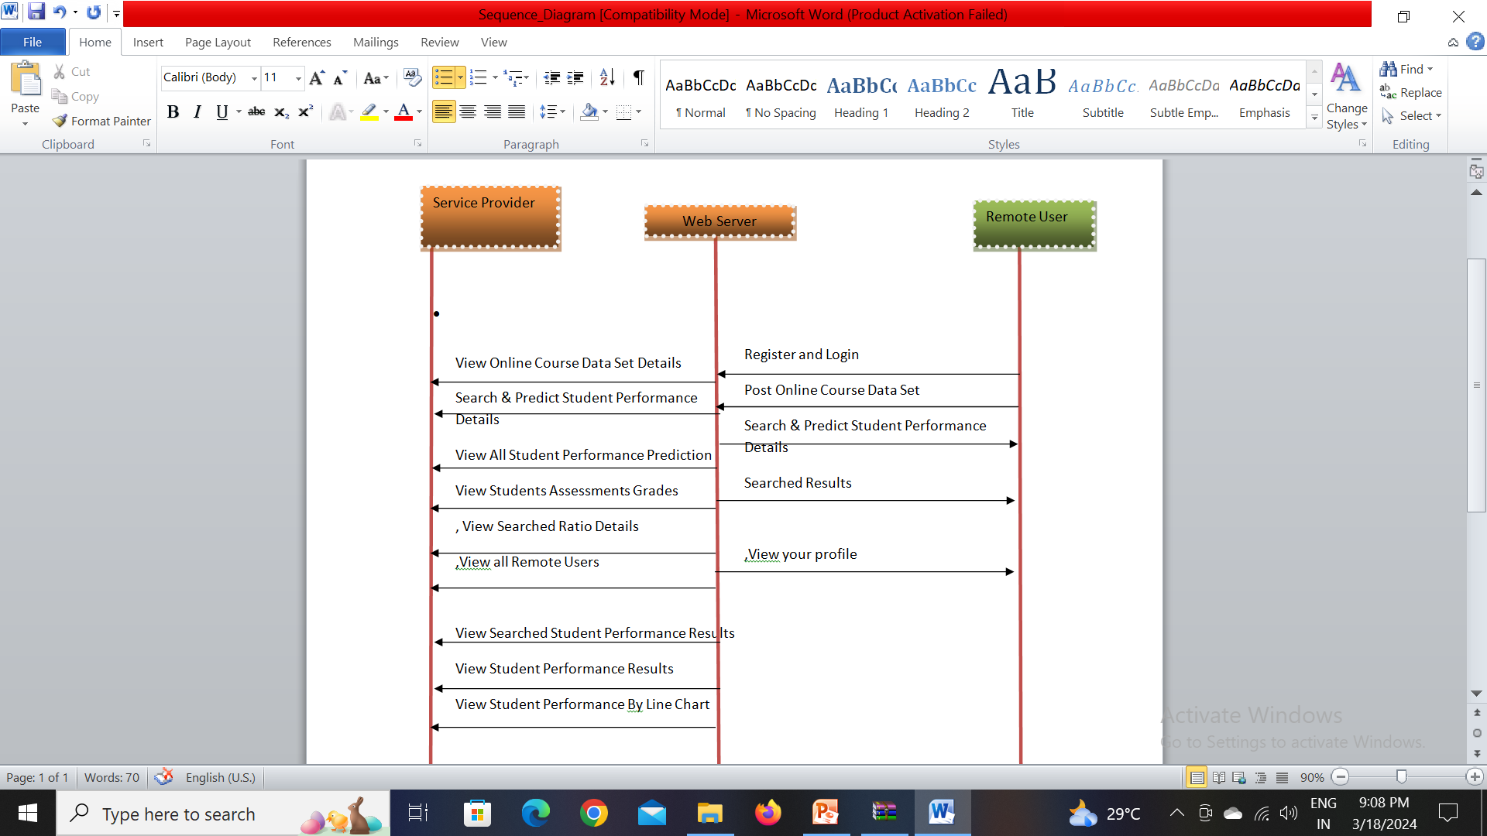
Sequence Diagram:

Slide 16
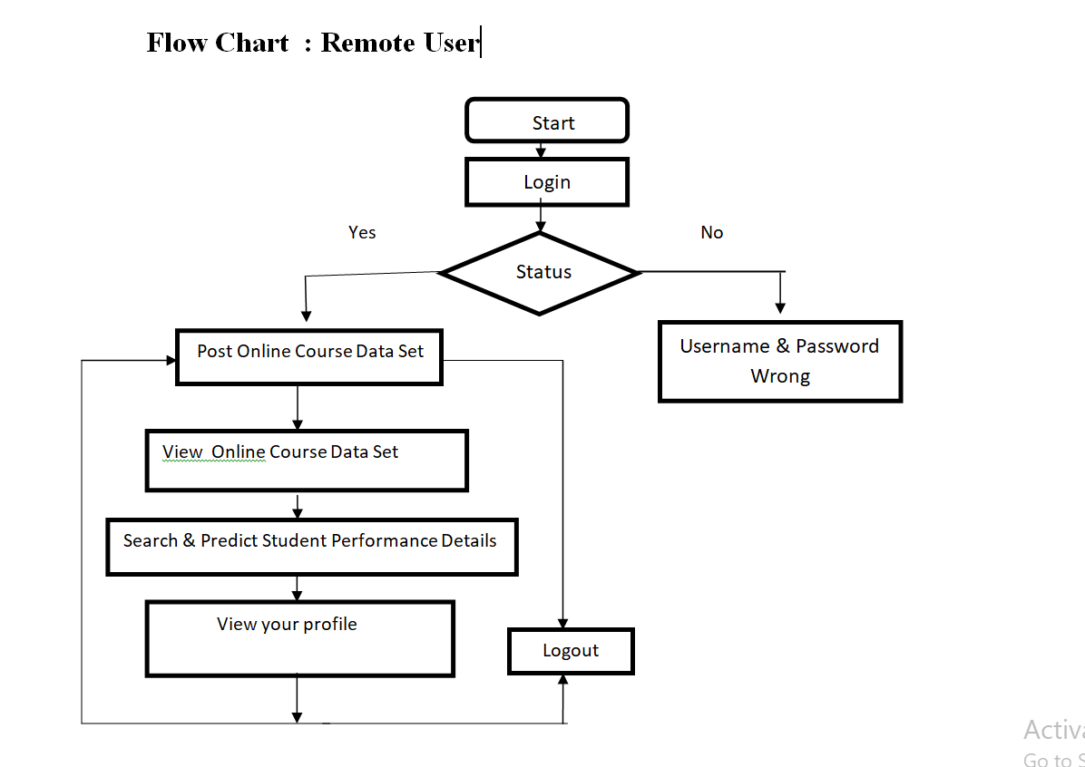
Activity Diagram:

Slide 17
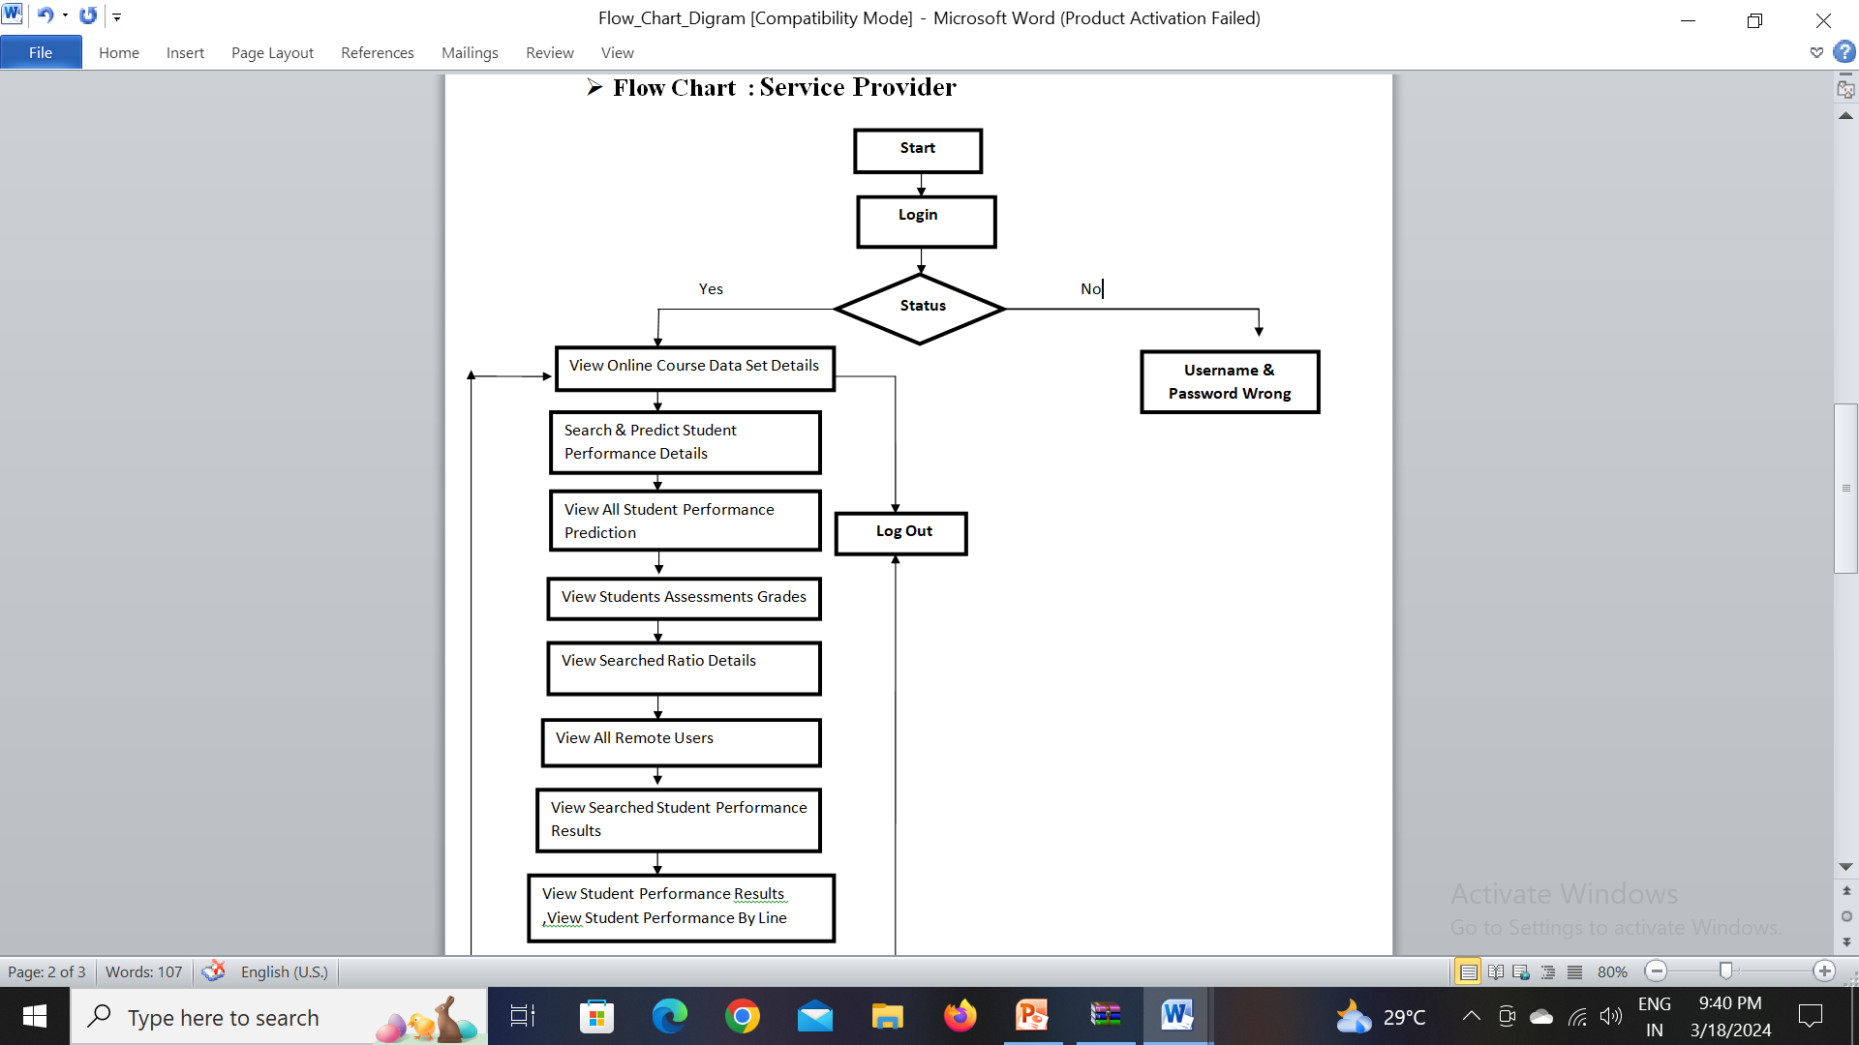

Slide 18
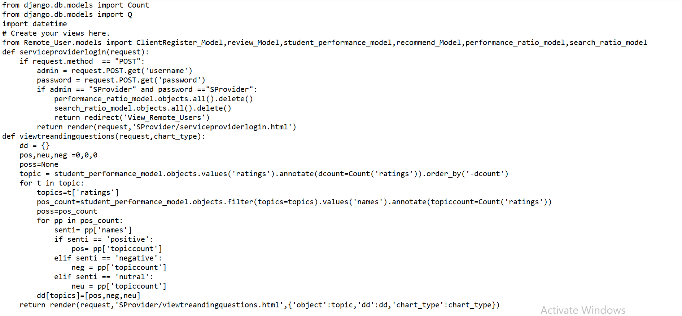
Sample Code Service Provider

Slide 19
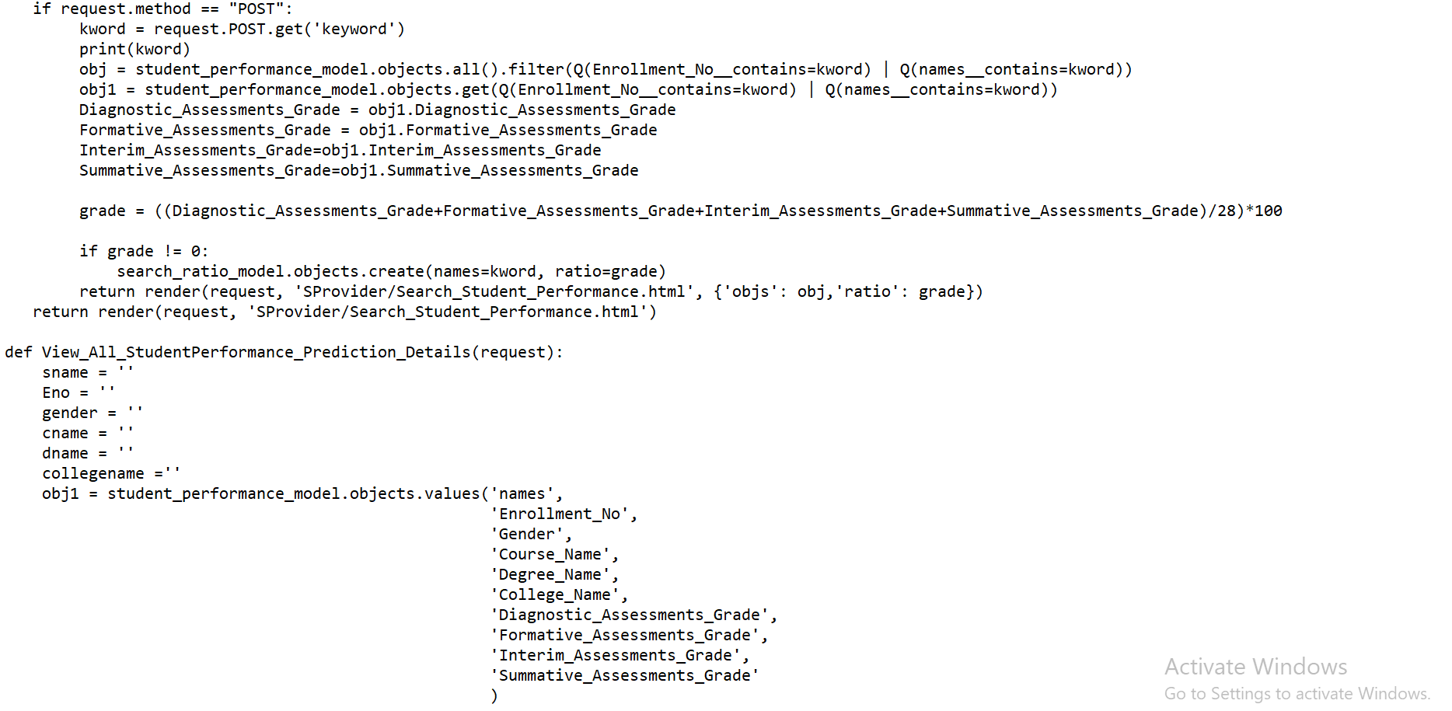

Slide 20
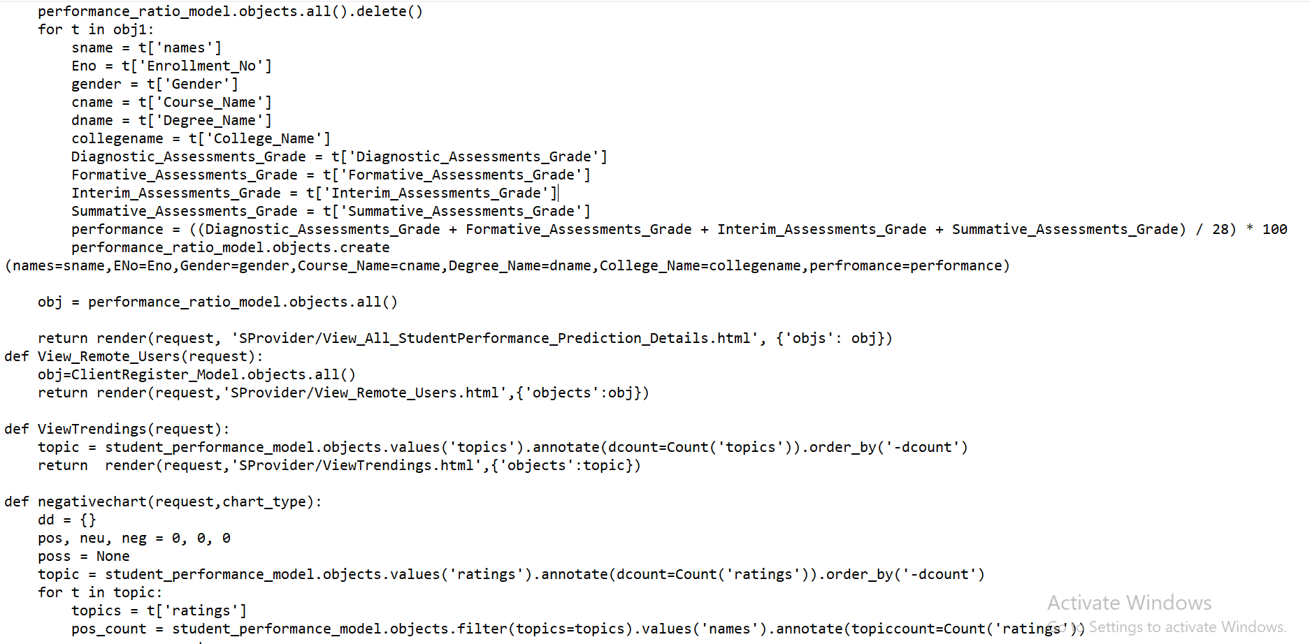

Slide 21
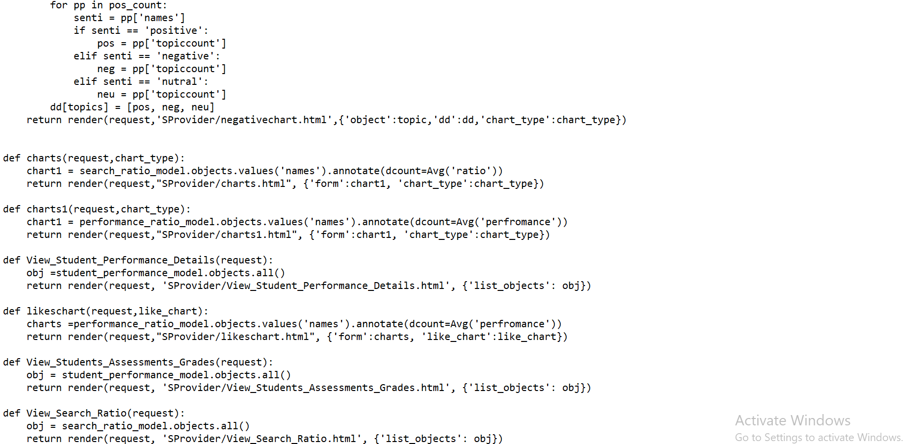

Slide 22
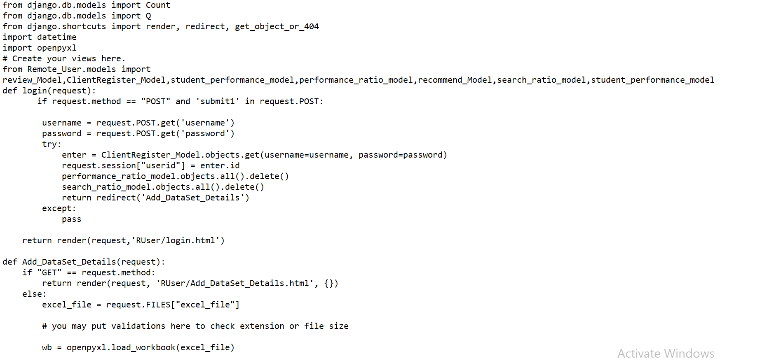
Remote User

Slide 23
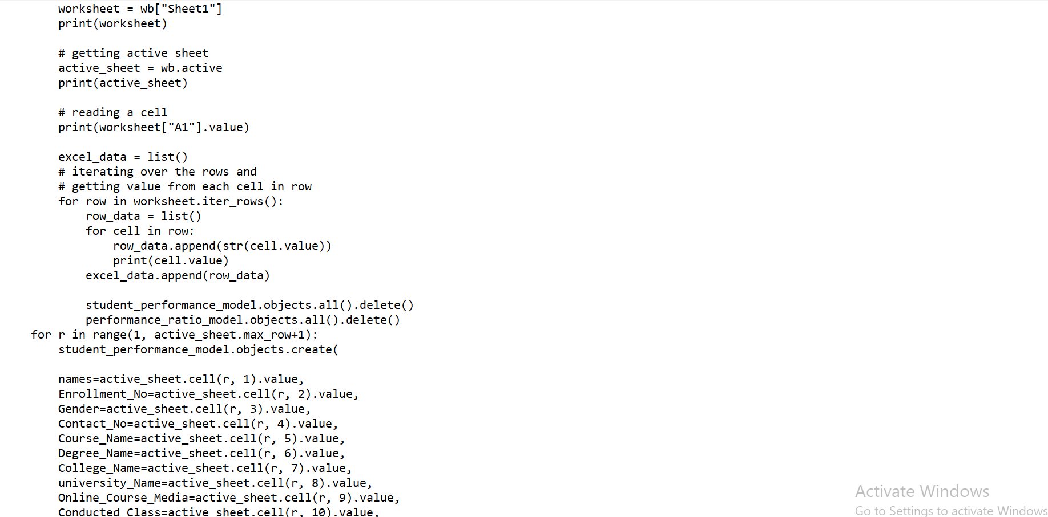

Slide 24
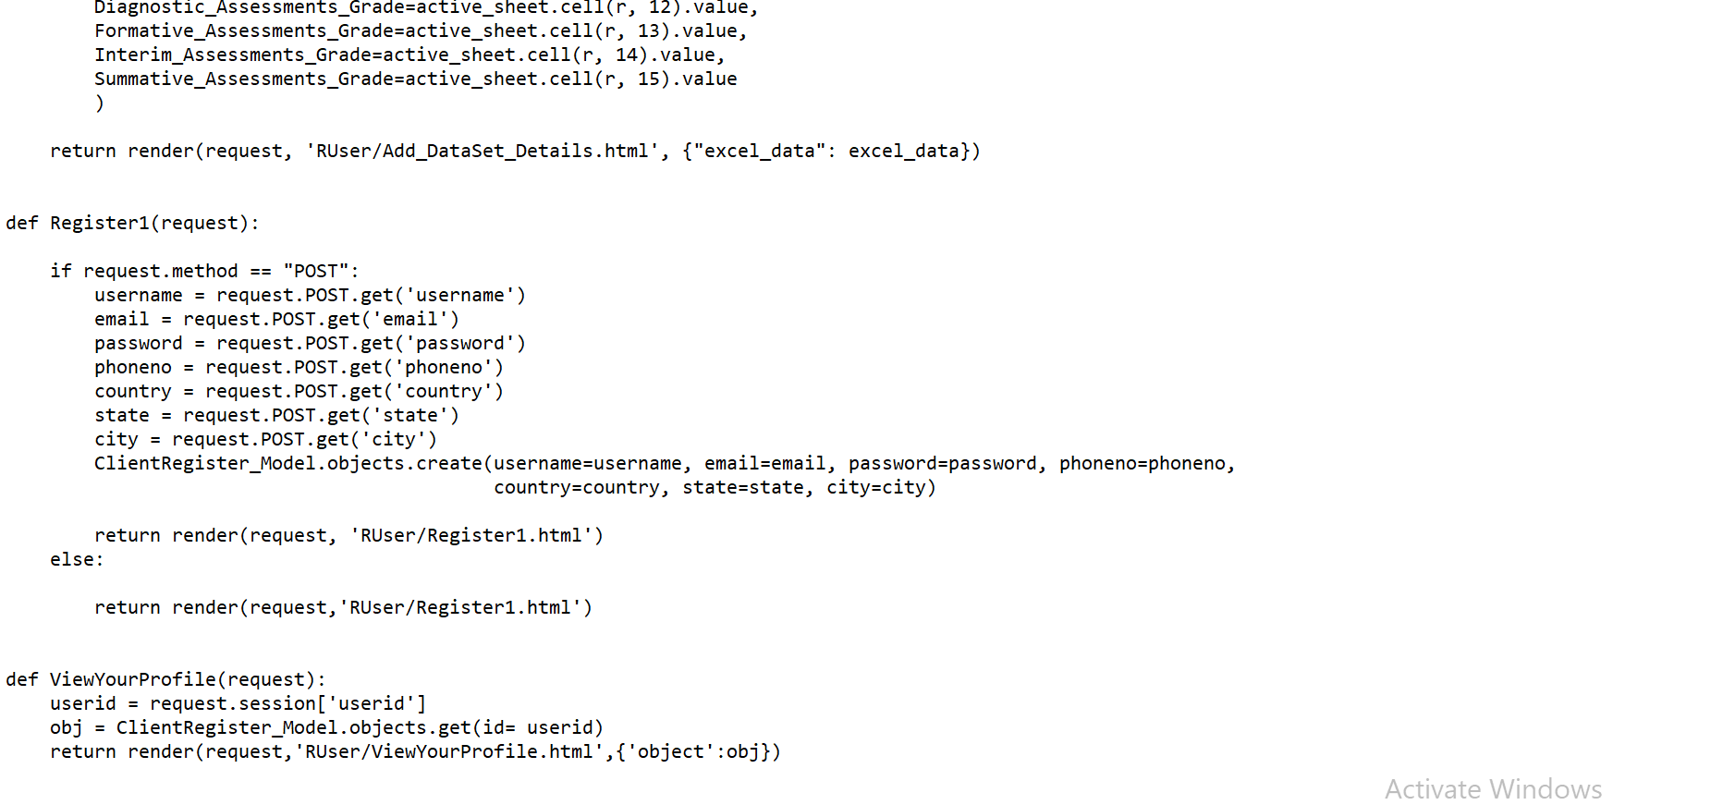

Slide 25
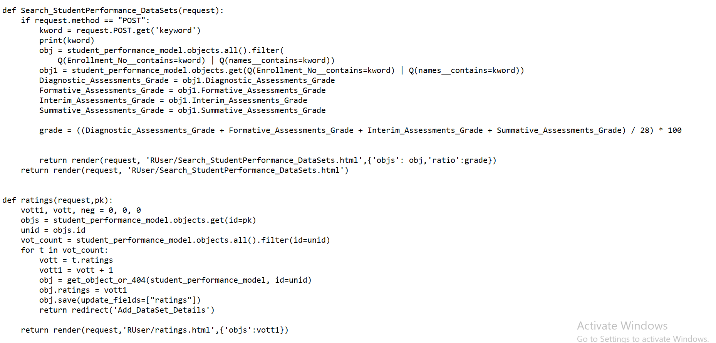

Slide 26
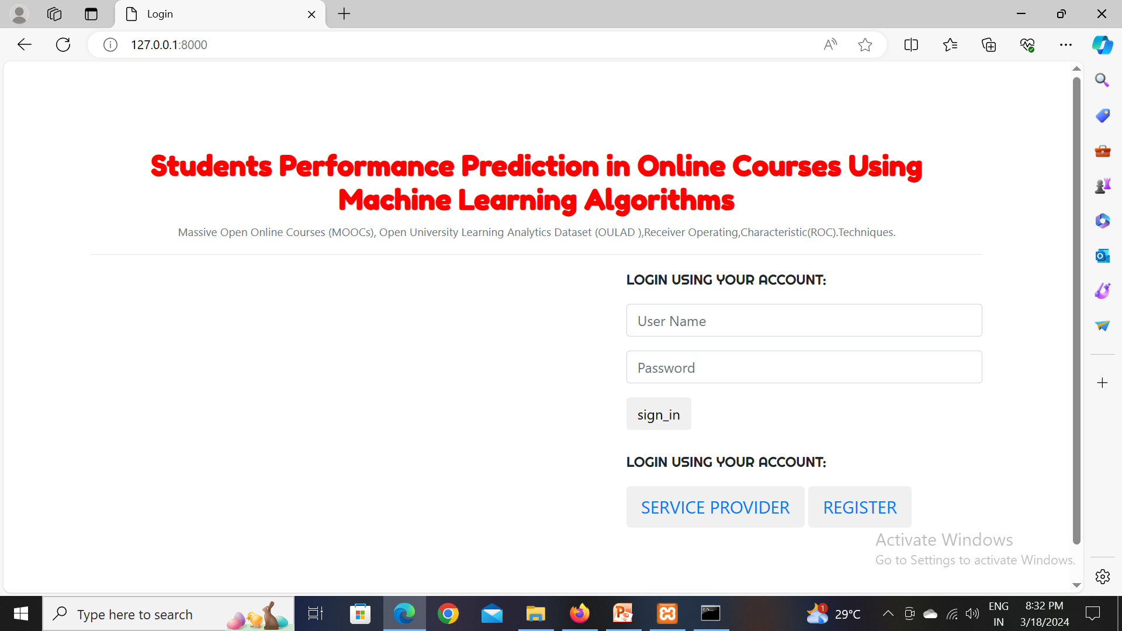
Result

Slide 27
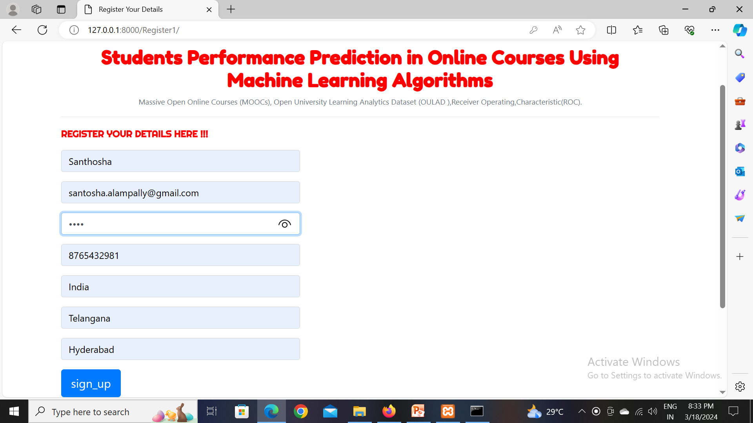

Slide 28
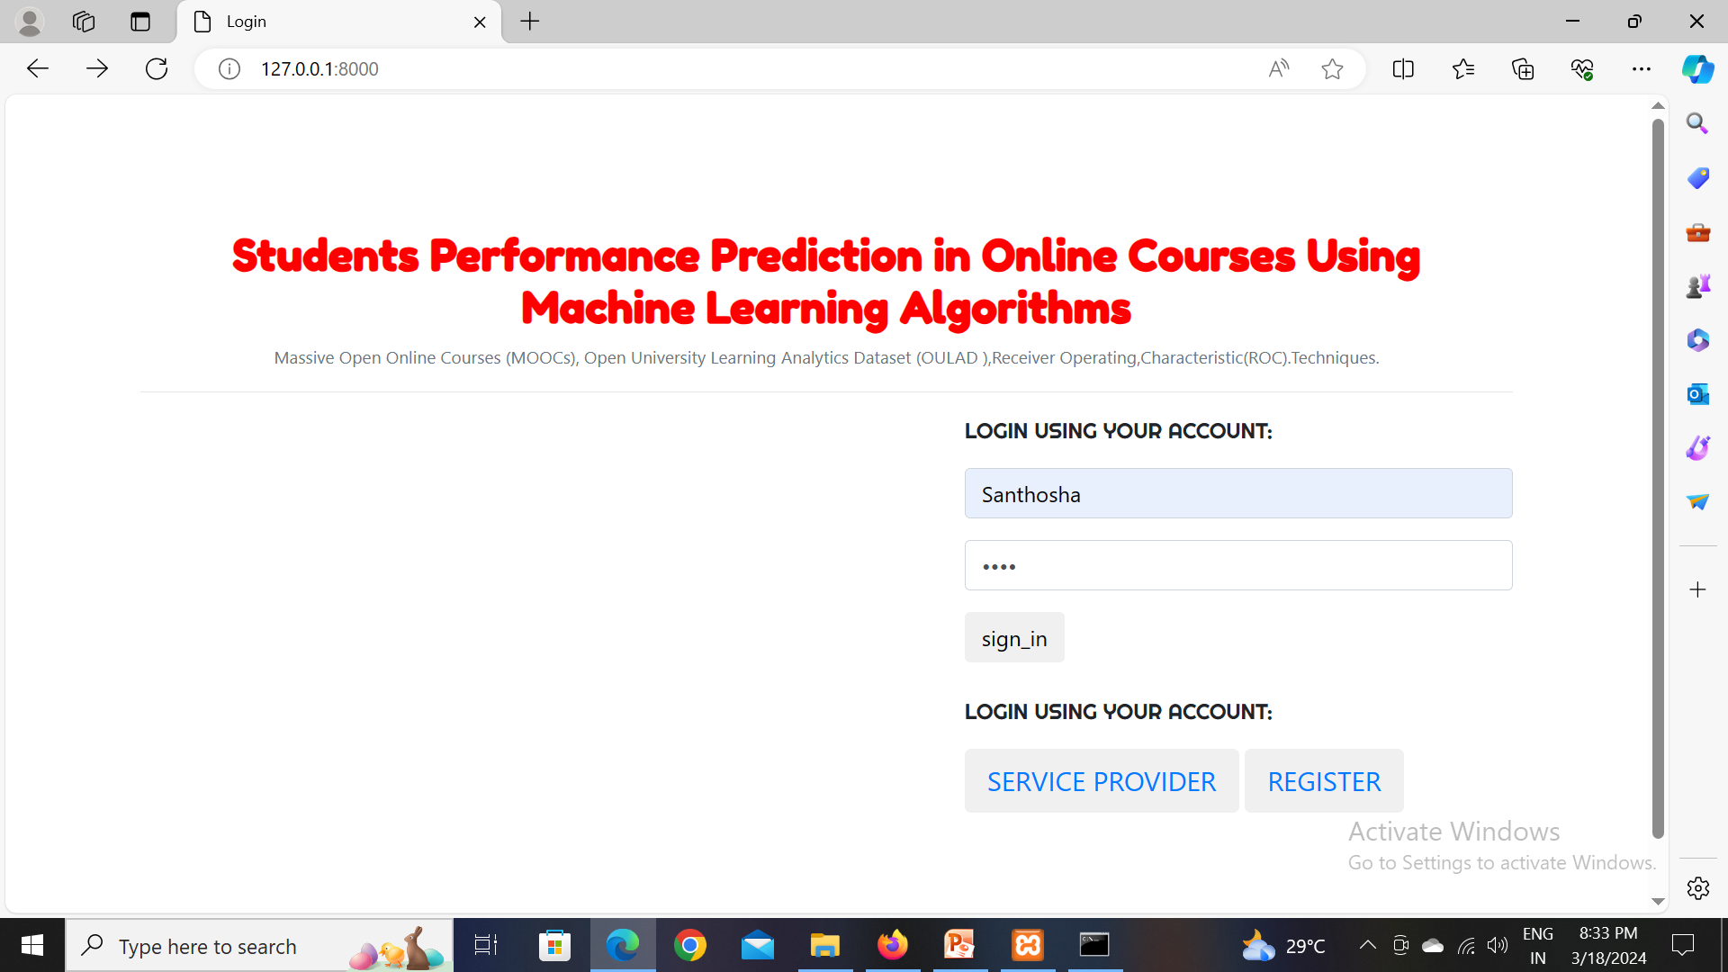

Slide 29
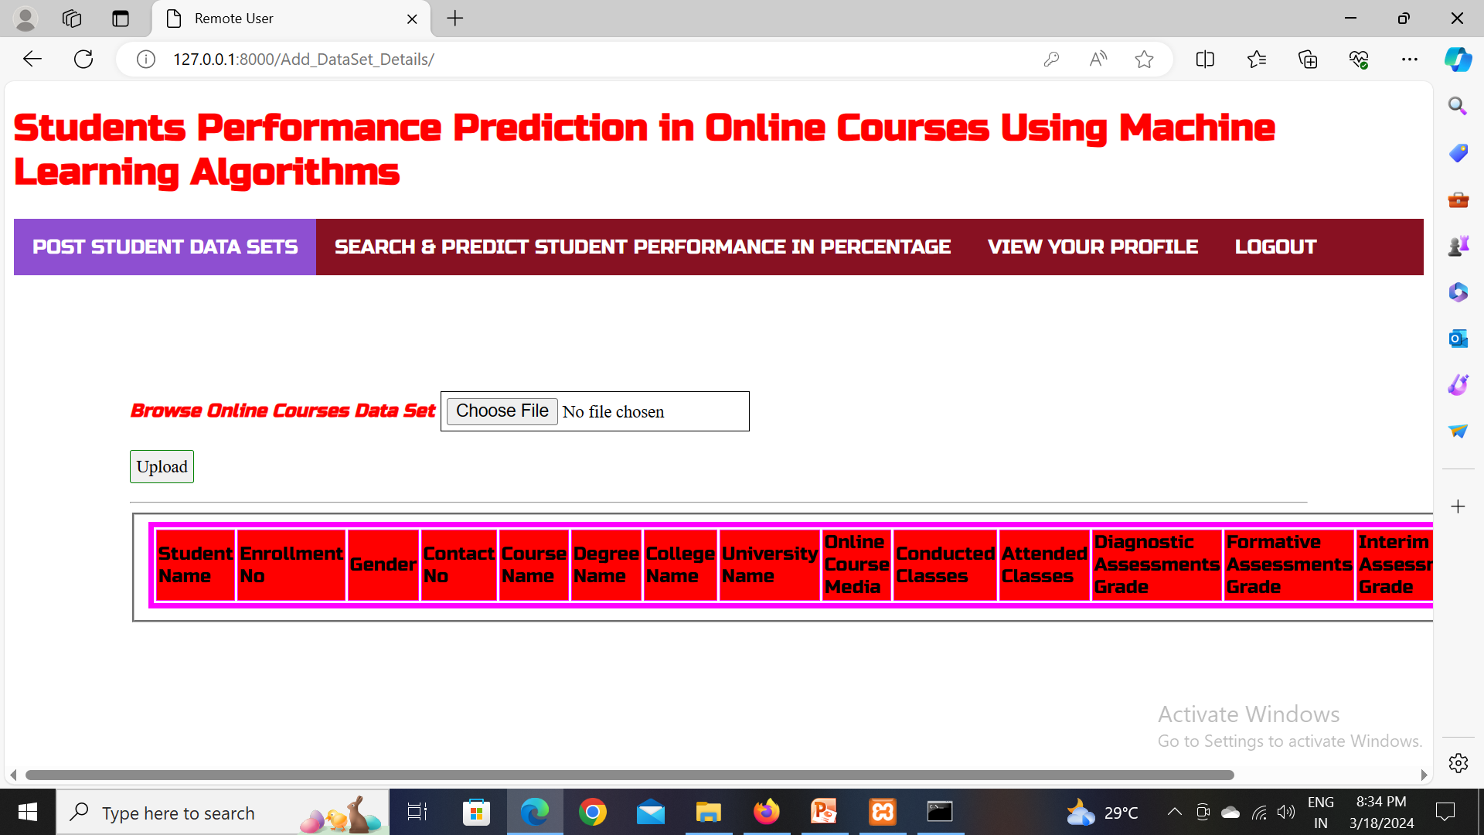

Slide 30
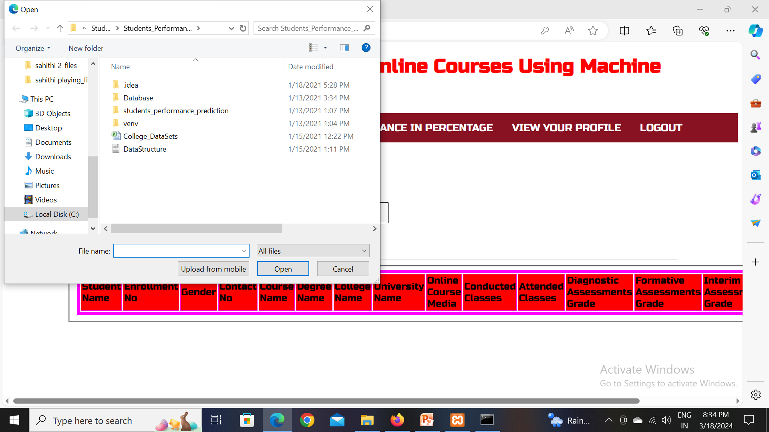

Slide 31
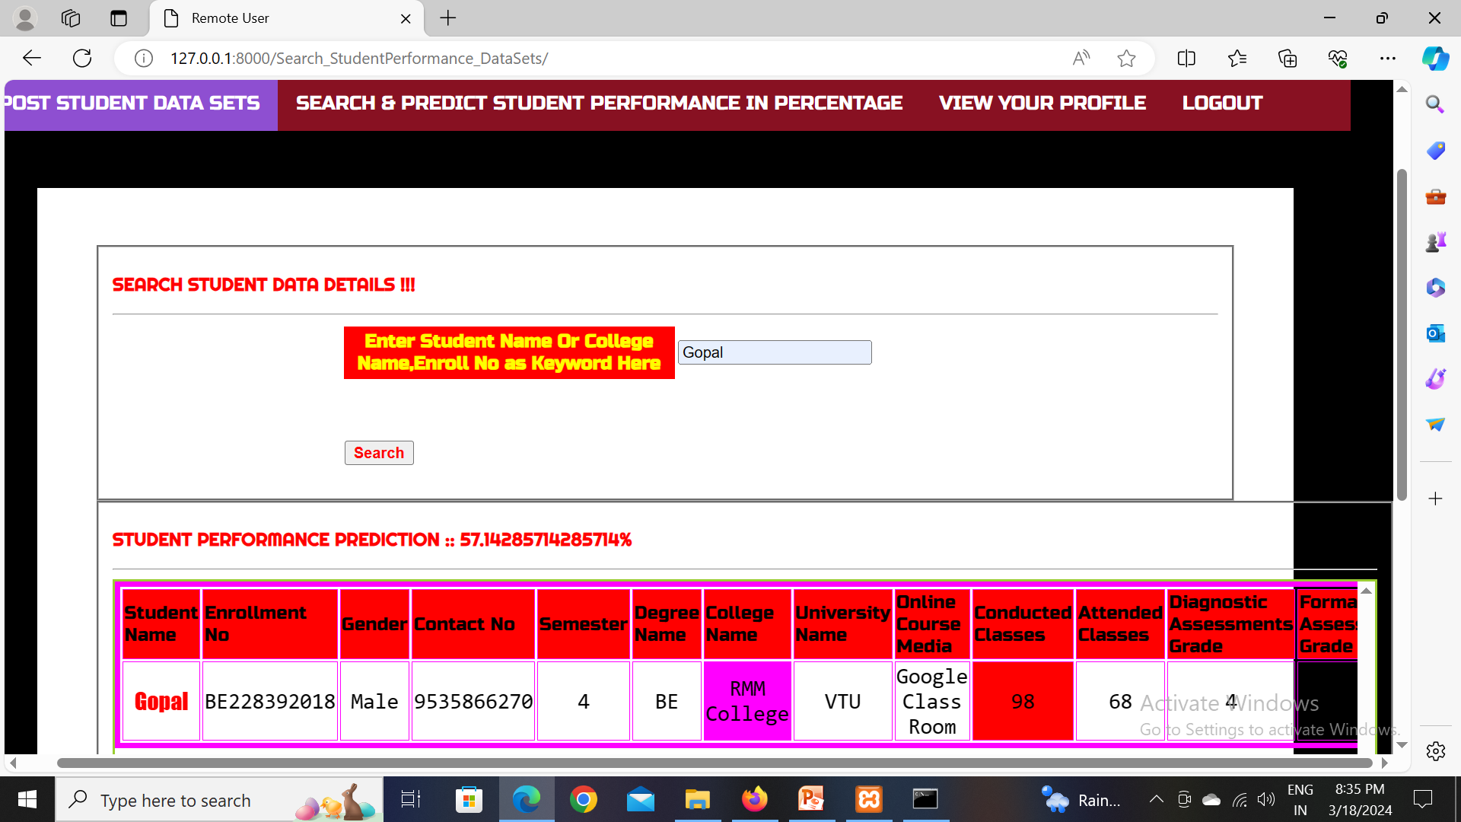

Slide 32
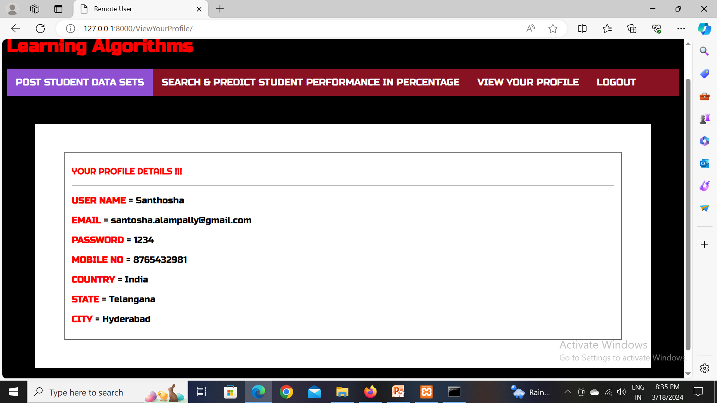

Slide 33
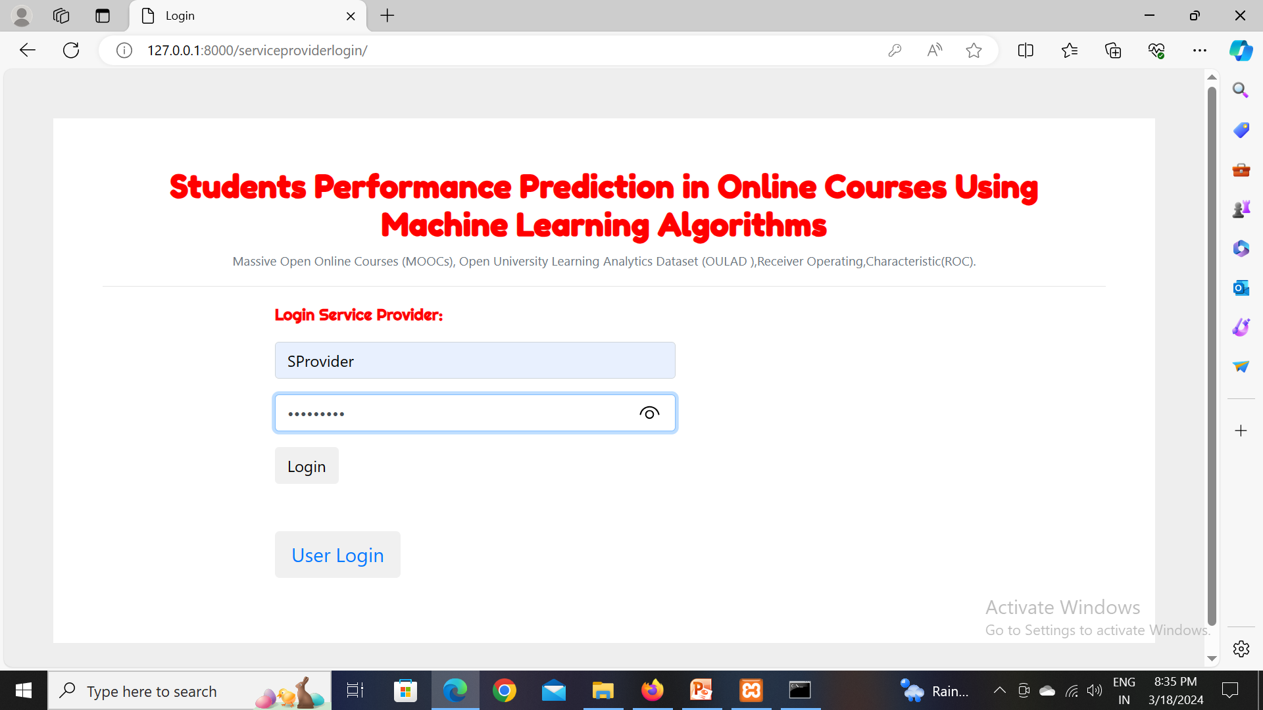

Slide 34
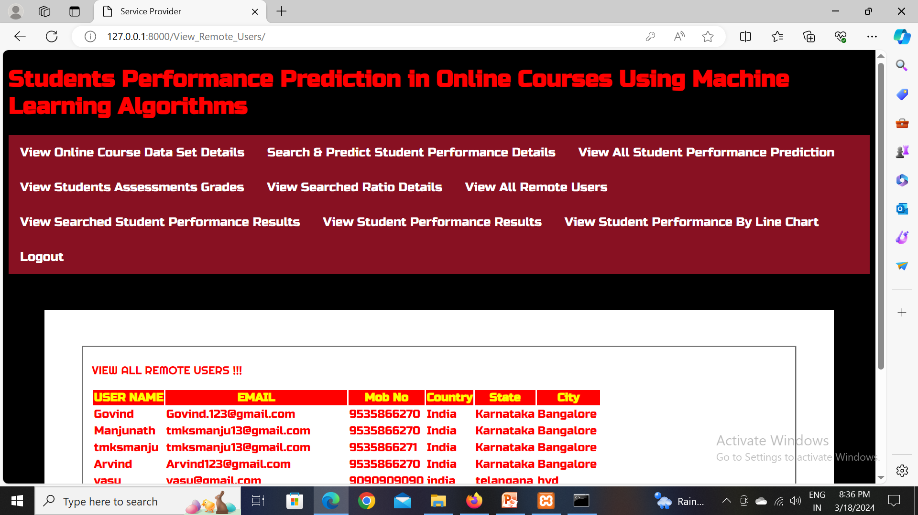

Slide 35
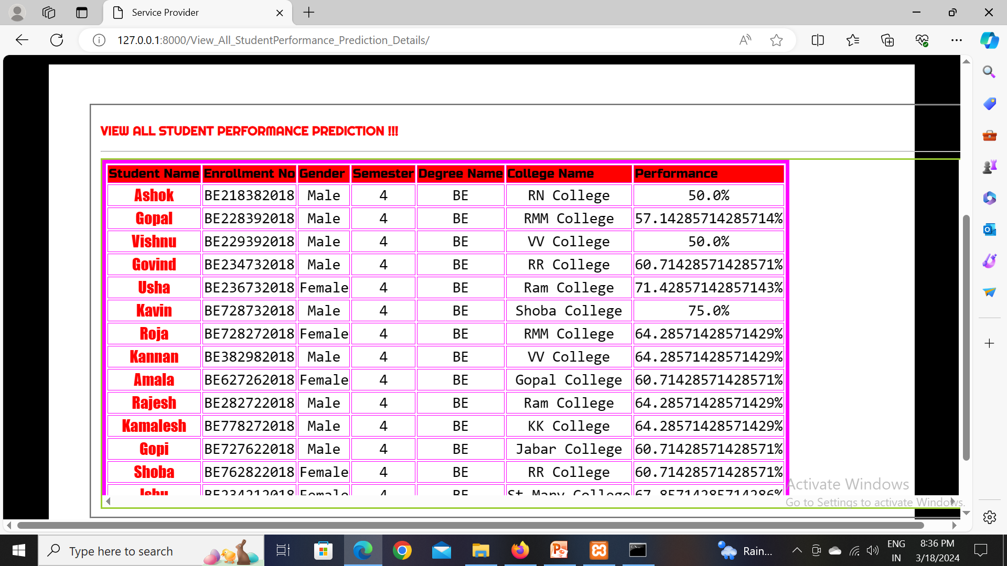

Slide 36
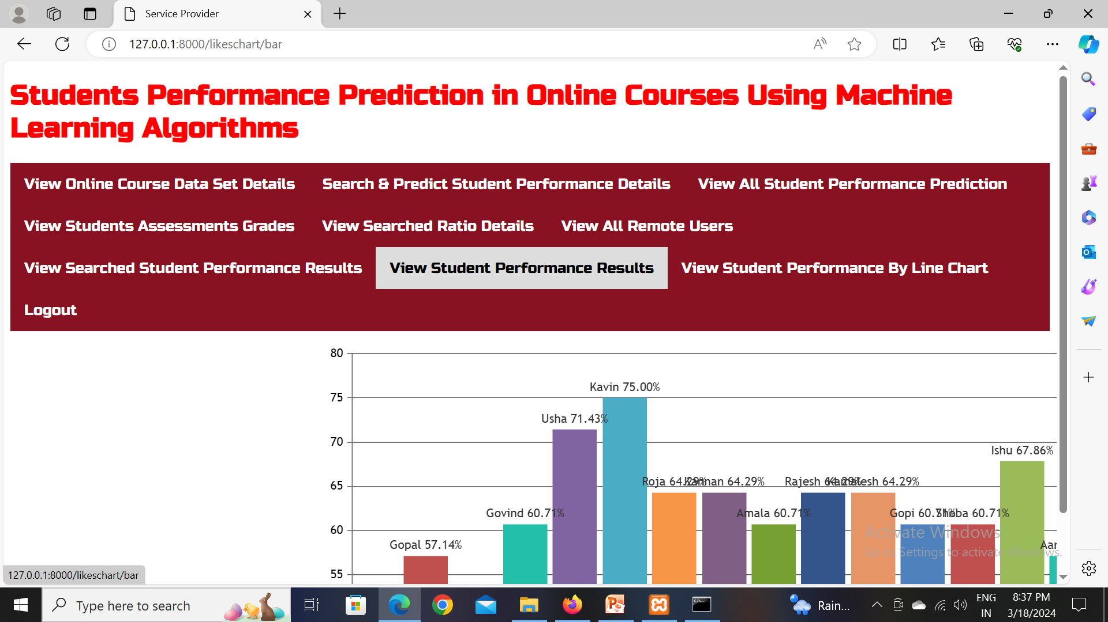

Slide 37
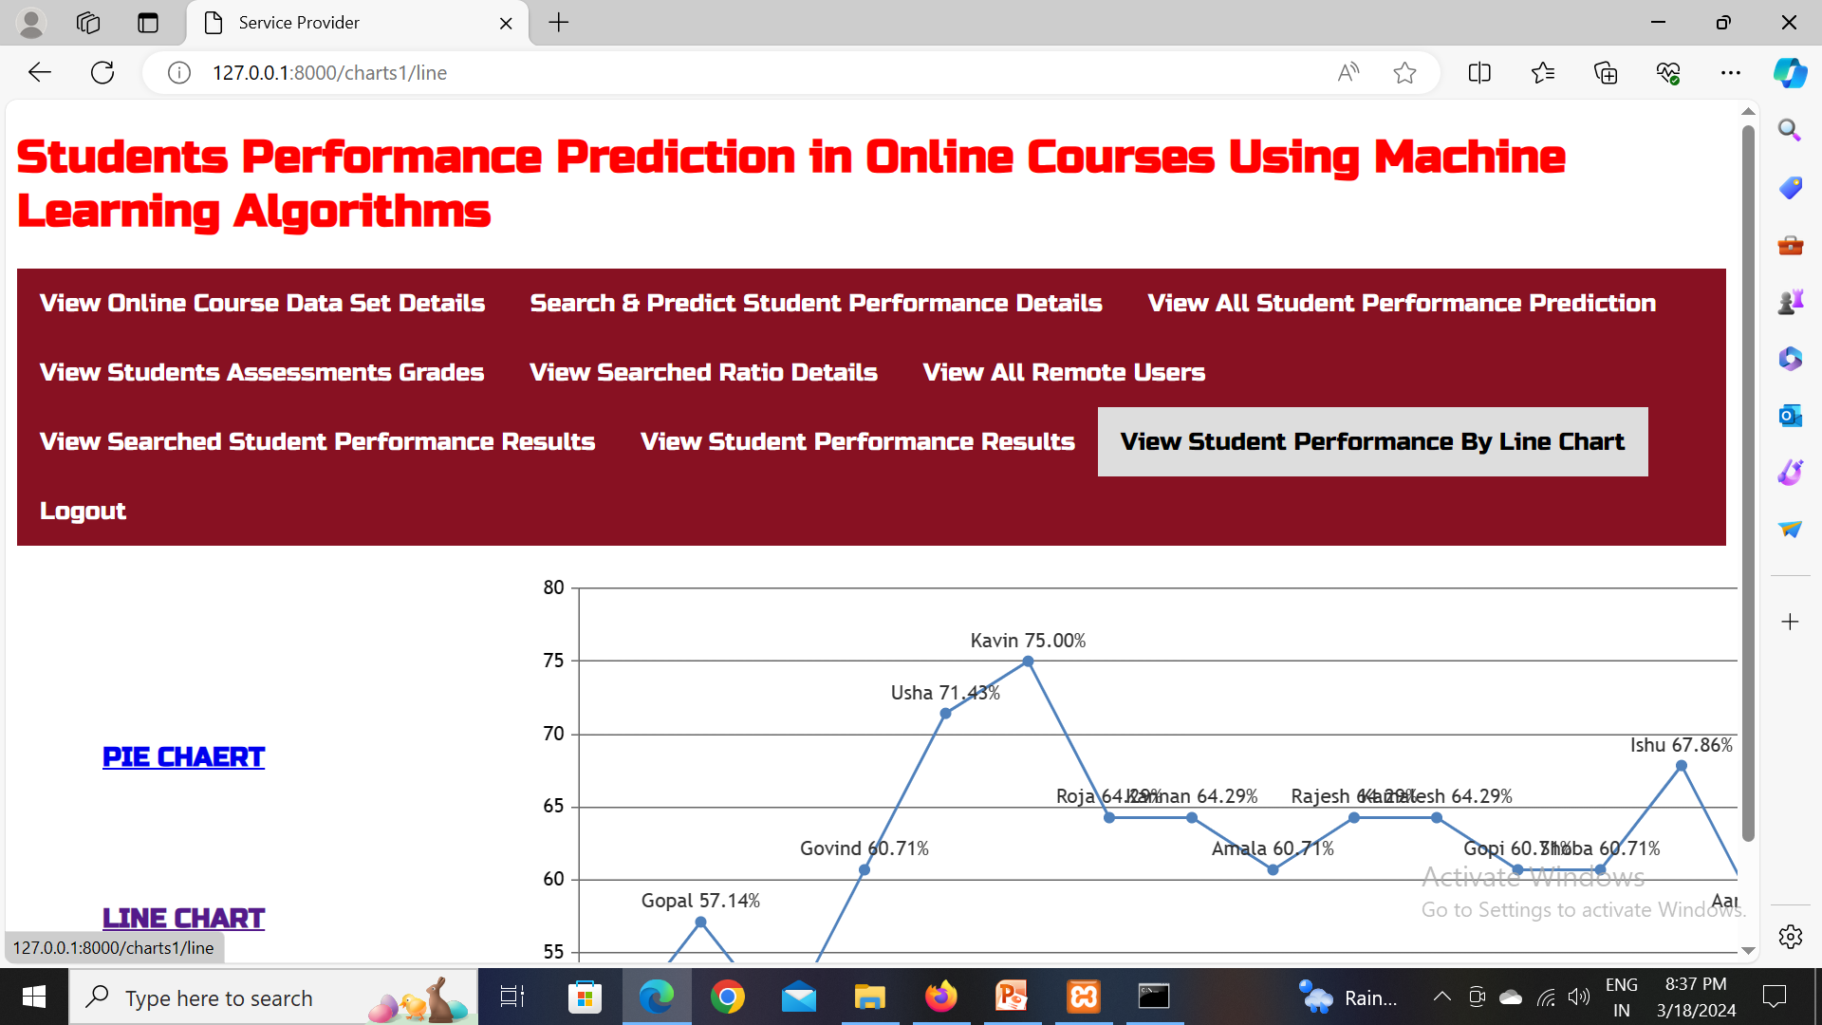

Slide 38
Conclusion :
In Conclusion, this project demonstrates how machine learning algorithms can accurately predict and improve student performance in online courses. By analyzing data and providing personalized support, the system helps students succeed by identifying challenges early and offering tailored interventions. Its continuous learning ensures on going effectiveness, making online education more personalized and successful for all students.

Slide 39
Future Scope
Incorporation of Advanced Data Sources: additional data sources, such as student-generated content , sentiment analysis of student feedback, or even physiological data (e.g., eye-tracking, facial expressions) to provide deeper insights into student learning behaviors and emotions.
Incorporation of Explainable AI (XAI): Integrating explainable AI techniques into the predictive models can enhance transparency and trust by providing clear explanations for model predictions.
Expansion to Other Educational Context :such as blended learning environments, traditional classrooms, or corporate training programs.

Slide 40
References
[1] H. B. Shapiro, C. H. Lee, N. E. Wyman Roth, K. Li,M. Çetinkaya-Rundel, and D. A. Canelas,
“Understanding the massive open online course(MOOC) student experience: An examination of
attitudes, motivations, and barriers” .Comput. Educ.,vol. 110, pp. 35–50, 2017.
[2] S. Zutshi, S. O’Hare, and A. Rodafinos, “Experiences in MOOCs: The Perspective of Students”
Am. J.Distance Educ., vol. 27, no. 4, pp. 218–227, 2013.
[3] M. J. Gallego Arrufat, V. Gamiz Sanchez, and E.Gutierrez Santiuste, “Trends in Assessment in
Massive Open Online Courses” ,Educ. Xx1, vol. 18,no. 2, pp. 77–96, 2015.
[4] J. Sinclair and S. Kalvala, “Student engagement inmassive open online courses” ,Int. J. Learn.
Technol.,vol. 11, no. 3, pp. 218–237, 2016.
[5] P. and K. Al-Shabandar, R., Hussain, A.J., Liatsis,“Detecting At-Risk Students With Early
InterventionsUsing Machine Learning Techniques,” IEEE Access,vol. 7, pp. 149464–149478, 2019.

Slide 41
Github link
https://github.com/rajendar2001/Students_perfomance_prediction_in_online_courses

Slide 42
THANK YOU

